Slide 1
基于贝叶斯推理的程序自动生成
-----徐忆清
导师: 武岳
Notes:
Good morning everyone. My name is Xu Yiqing. My uspervisor is Prof Khoo. Today I will give the presentation about program synthesis using probabilistic programming.

Slide 2
目录
简介
概率编程
程序综合
Metropolis-Hastings算法
实验部分
Notes:
I’ve divided the presentation into several parts. Firstly, I will give a quick introduction. Then I will introduce what is probabilistic programming, what is program synthesis and an important algorithm Metropolis-Hastings. Later I will focus on an example showing how to do program synthesis using PPL.

Slide 3
简介
程序综合: 在程序空间中自动发现满足一定规范的程序的任务。
概率编程: 利用计算机科学的工具进行贝叶斯推理。
我们使用概率编程语言 (PPL) 表示一个生成模型, 该模型在重复执行时, 会生成计算机程序代码和输出条件, 并且符合观察到的规范。
Notes:
The goal of our project is to synthesize program using Probabilistic programming.
...
Here we mention Bayesian inference and “generative model”, so before having a further understanding of PP, let’s first see what Bayesian inference and the model are.

Slide 4
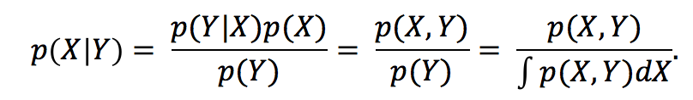
Introduction - Bayes’ Theorem
Notes:
Bayesian inference is a method of statistical inference in which Bayes' theorem is used. (to update the probability for a hypothesis as more evidence becomes available.)
This is the bayes’ theorem, where X and Y are events. Bayes’ theorem provides us with a way to update our beliefs of X based on the arrival of new, relevant pieces of evidence Y.

Slide 5
Introduction - Bayesian Inference
X: Biased probability of getting “head”
Y: side of coin after flipping
likelihood
prior
generative model
posterior
marginal likelihood
Notes:
For example, if we flip the coin, suppose different coins have different biased probability of getting head, X is the biased probability, Y is the side of the coin, can either be head or tail. P(X) is the prior distribution of X, that is our initial belief of X without observed data Y. P(x|y) is posterior distribution of x given y, meaning our updated belief of x after observ Y. P(y|x) is the likelihood, means the probability of getting y given biased probability x. p(y) is marginal likelihood, this is the total probability of observing the evidence, it should be a constant given y.
We mentioned that Probabilistic programming language denotes a model, for our purpose, the generative model is the joint distribution p(x,y).
And how does probabilistic programming perform bayesian inference using tools of computer science?

Slide 6
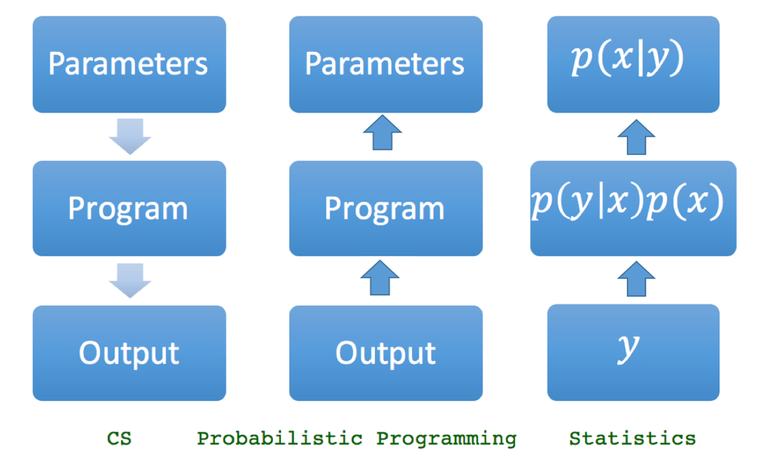


Probabilistic programming - Intuition
typical computer science
Notes:
In typical computer science, which is in the left of the figure: we write a program, specify the values of its parameters, then evaluate the program to produce an output.
While statistics on the right of figure is just the opposite. It starts with the output, the observations y, then specify a usually abstract generative model , often denoted mathematically, and finally use inference techniques to characterize the posterior distribution.
In probabilistic programming, the model is denoted by programming language, the observation is the output of the program, which are already known to us. Statistical inference algorithms will be used to compute the conditional distribution of program inputs that could have given rise to the observed program output.
Then how to denote the model using PPL? Let’s see the coin flipping model again.

Slide 7
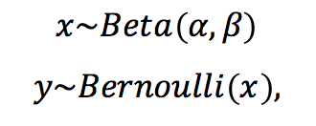
Probabilistic programming – Coin Flipping Model
Notes:
Here x is bias of coin, y the side of coin. And x samples from beta distribution with parameters a and b. y samples from bernoulli distribution with parameter x.

Slide 8
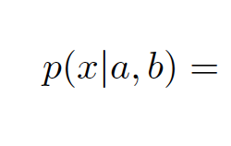
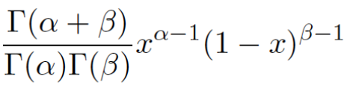

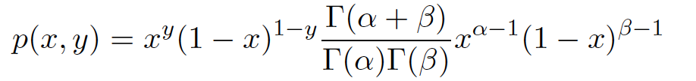
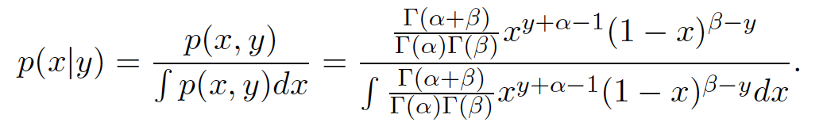
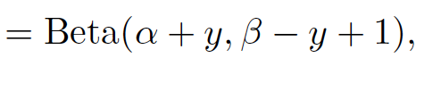
Probabilistic programming – Coin Flipping Model
Notes:
Here x is bias of coin, y the side of coin. And x samples from beta distribution with parameters a and b. y samples from bernoulli distribution with parameter x.
So the prior probability distribution function is like this. And we get get joint distribution like this. And the posterior distibution is like this.
We do not need to know how to calculate the distribution, here I just want to show that we can know the distribution directly.

Slide 9
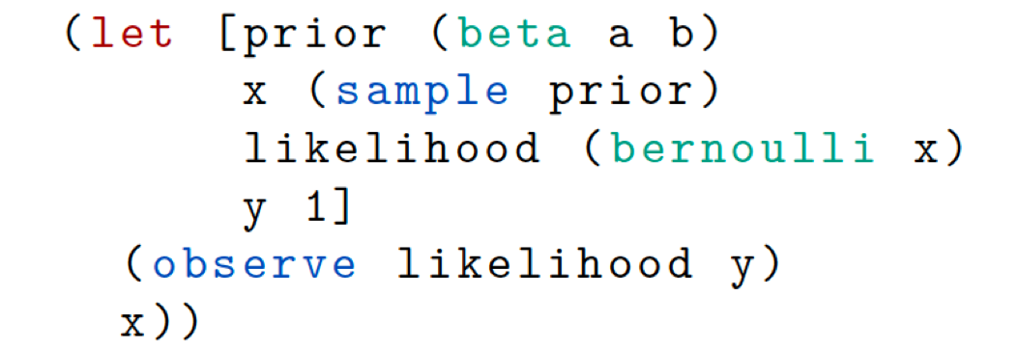



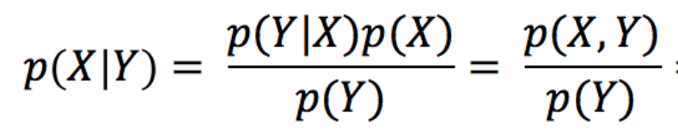

Probabilistic programming - Anglican
Notes:
Here is the probabilistic program code that denote coin flipping. It is written in Anglican, which is a probabilistic programming language.
Firstly we let “prior” denote prior distribution of biased probability, which is beta(a,b). (sample prior) means get one sample from prior distribution, for example, x maybe 0.9, 0.5. When we have the biased probability of a coin x , we can also get likelihood function, here the likelihood function is bernoulli distribution of given parameter x. The output y is 1 in this example. “observe” will perform bayesian inference and update the distribution of x. After “observe” the observed output , distribution of x is posterior distribution. So at last, this x is not the sample from Beta(a,b), but Beta(a+y,b-y+1).
Now we have already know what probabilistic programming is, then what is the connection between this one and program synthesis?

Slide 10
Program synthesis - Stochastic search
Stochastic synthesis approach learns a distribution over the space of programs in the hypothesis space that is conditioned on the specification, then we use the learnt distribution to guide the search of programs that are more likely to lead to programs that conform with the specification.
Notes:
There are several search methods in program synthesis, one of them is stochastic search.

Slide 11
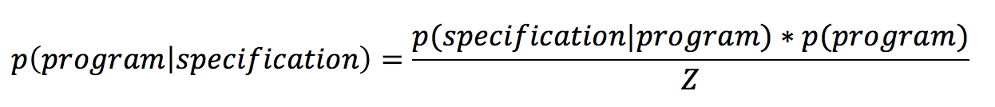
Program synthesis - Stochastic search
Stochastic synthesis approach learns a distribution over the space of programs in the hypothesis space that is conditioned on the specification, then we use the learnt distribution to guide the search of programs that are more likely to lead to programs that conform with the specification.
Notes:
Recall bayesian inference. Now x is program,y is specification of program. Here the marginal likelihood is a constant, we let it to be Z.

Slide 12
Program synthesis - Stochastic search
What we know: prior distribution
What we want to know: posterior distribution
Notes:
So now, what we know is prior distribution that is initial distribution of program over program space. What we really want is posterior distribution of program over program space. So can we use the bayesian inference just like coin flipping example? Probably not. In coin flipping, the posterior distribution can be calculated. However, in program synthesis, the space of program is usually very complex, so even we have 1000 dimension, each dimension has 2 choices, we will have a considerable choices of program. That makes it difficult to get Z.
Luckily, what we really want to get is not the posterior distribution, but the program samples that are from posterior distribution. And now, since we don’t know posterior distribution, we cannot directly get these program samples.
So we will introduce an algorithm called Metropolis-Hastings, it can guide the search procedure from getting program samples from prior distribution to that from posterior distribution.

Slide 13
Metropolis-Hastings – Algorithm of Monte Carlo Markov Chain
Markov Chain Monte Carlo(MCMC) is a family of algorithms, rather than one particular method.
Metropolis–Hastings algorithm is a Markov chain Monte Carlo (MCMC) method for obtaining a sequence of random samples from a probability distribution(we call “target” distribution) from which direct sampling is difficult. To accomplish this, the algorithm uses a Markov chain which asymptotically reaches a unique stationary distribution that equals to our target distribution.
Notes:
The probability distribution in program synthesis is posterior distribution.
Why Markov chain is so magical? Let’s see some properties of Markov chain.

Slide 14
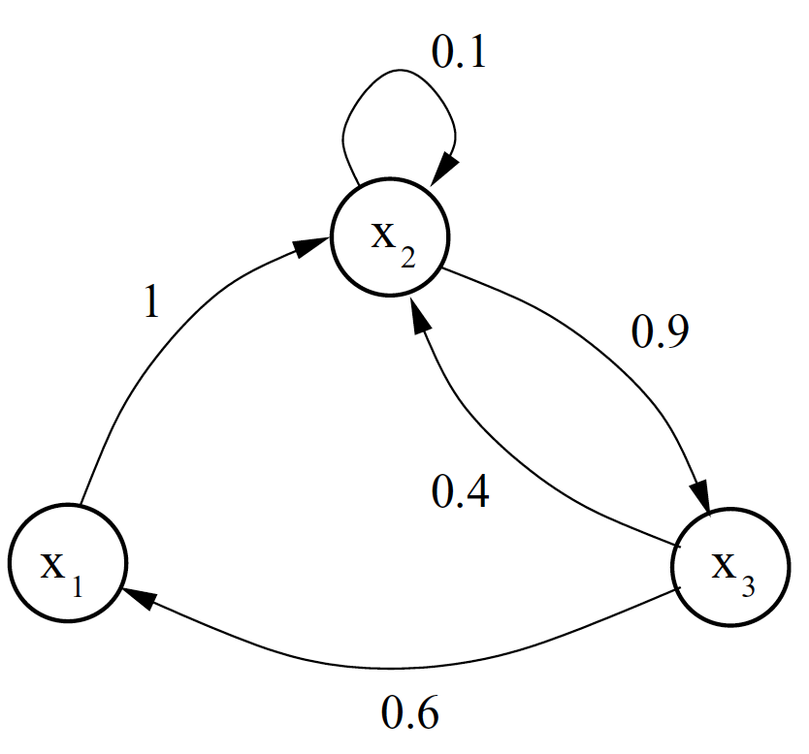
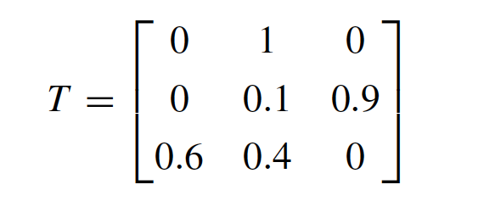



Metropolis-Hastings - Markov Chain
Notes:
A stochastic process is called markov chain if the probability of next state only depends on current state. Suppose we have three states x1, x2, and x3. There is a transition matrix T, it describes the probability that one state transit to another state including itself. If the probability vector for the initial state is like this. … The next state is like this.
Interestingly, after several iterations (multiplications by T), the product converges to p(x). No matter what initial distribution we use, the chain will stabilise at an invariant distribution p(x).
The markov chain will converges as long as for each state, it can visit other states, and the state will not trap in loop. If there is no this line, and line, the chain will trapped in loop.

Slide 15
Metropolis-Hastings – Algorithm of Monte Carlo Markov Chain
Markov Chain Monte Carlo(MCMC) is a family of algorithms, rather than one particular method.
Metropolis–Hastings algorithm is a Markov chain Monte Carlo (MCMC) method for obtaining a sequence of random samples from a probability distribution(we call “target” distribution) from which direct sampling is difficult. To accomplish this, the algorithm uses a Markov process which asymptotically reaches a unique stationary distribution that equals to our target distribution.
Notes:
And the idea of MH is to make our target distribution as invariant distribution of Markov chain

Slide 16
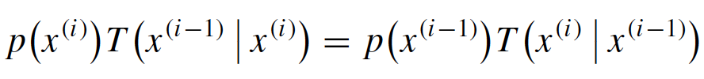
Metropolis-Hastings - Markov Chain
Reversibility (detailed balance) condition
Notes:
A sufficient, but not necessary, condition to ensure that a particular distribution is invariant is the reversibility (detailed balance) condition.
Here, p(xi) means probability of x, T(xi-1| xi) means probability that state in i transit to state in i-1.
I will skip the mathematical proof, but i will give you a intuition. I will skip the mathematical proof but we can think it in this way. A group of people have only 100 dollar, For each person xi, 100*p(xi) is the money that person i has, T(xi-1|xi) is the percentage of the money that person i will give to person i-1. If for each person, the money I give you is equal to you give me, then sure the money each person has will not change. So the distribution is invariant.
Now the problem is given a transition distribution of current state i that is easy to sample, for example, is uniform distribution, this condition will not be valid all the time. So this uniform distribution is not the transition distribution, but it can be the proposal distribution that propose a next state. And we will use this proposal distribution and an acceptance probability to create the transition distribution.

Slide 17

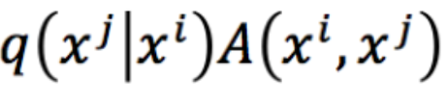
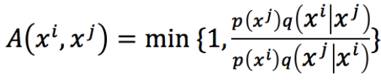
Metropolis-Hastings - Algorithm
Transition probability from i to j:
Notes:
P(x) is our target distribution. Here q means the proposal distibution. Now our transition probability of each state i to state j is q*A.

Slide 18
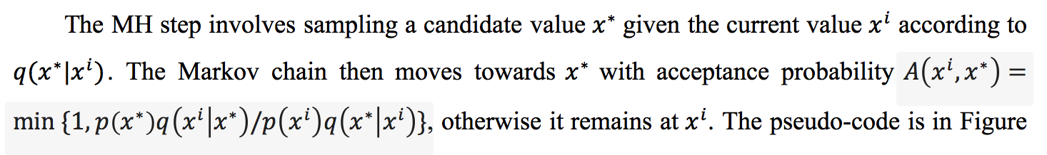

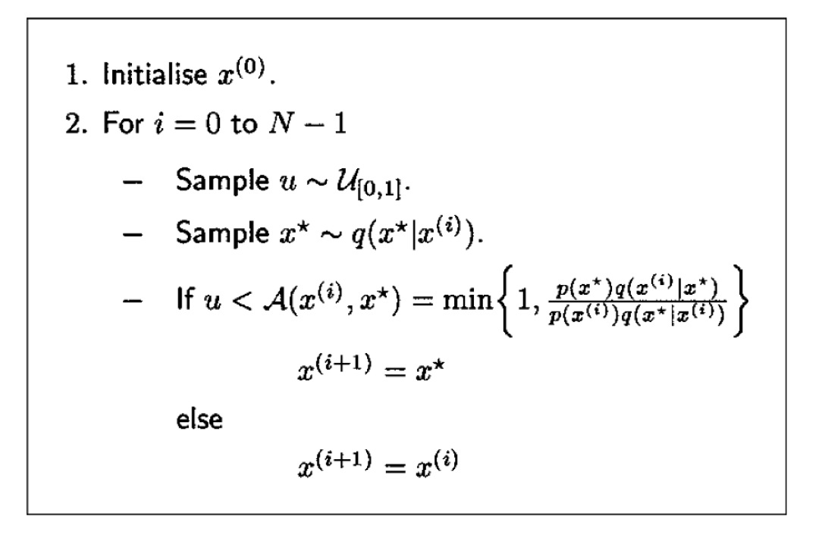

Metropolis-Hastings - Algorithm
Notes:
This figure shows how to run MH. first, we have an initial sample x0, then we will run MH for N times, each time doing the MH
After running this steps for some time, we can reach the invariant target distribution, which is posterior distribution. Therefore, the samples at that time are sampled from posterior distribution. In thsi way we get the program samples we want.
Now we know the algorithm of MH, will explain how it works in program synthesis.

Slide 19
Metropolis-Hastings
The initial guess might be very wrong, the first part of the Markov chain should be ignored: these early samples cannot be guaranteed to be drawn from the target distribution.
Notes:
Some properties of the MH algorithm are worth highlighting.

Slide 20
Metropolis-Hastings
The success or failure of the algorithm often hinges on the choice of proposal distribution. If the proposal is too narrow, it runs the risk of getting stuck in local maxima: areas where the likelihood is higher for a certain value than for its close neighbors, but lower than for neighbors that are further away.
On the other hand, if it is too wide, then many of the proposals would be outside the target distribution, the rejection rate can be very high.
Notes:
Now we know the algorithm of MH, will explain how it works in program synthesis.

Slide 21
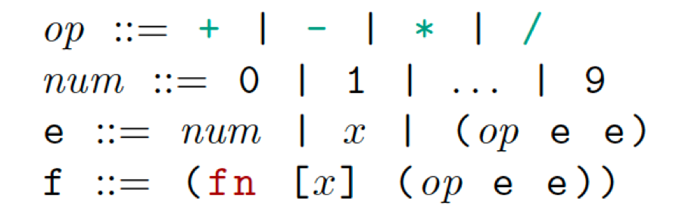
Program synthesis using PPL
In our example. the synthesized program is to encode mathematical functions. We will use probabilistic program, which represent procedure of generative model, to produce the function that satisfy the input-output examples using MH algorithm.
Notes:
In this example, the program is to encode mathematical functions. This is the syntax of the program, the function could be like this.

Slide 22
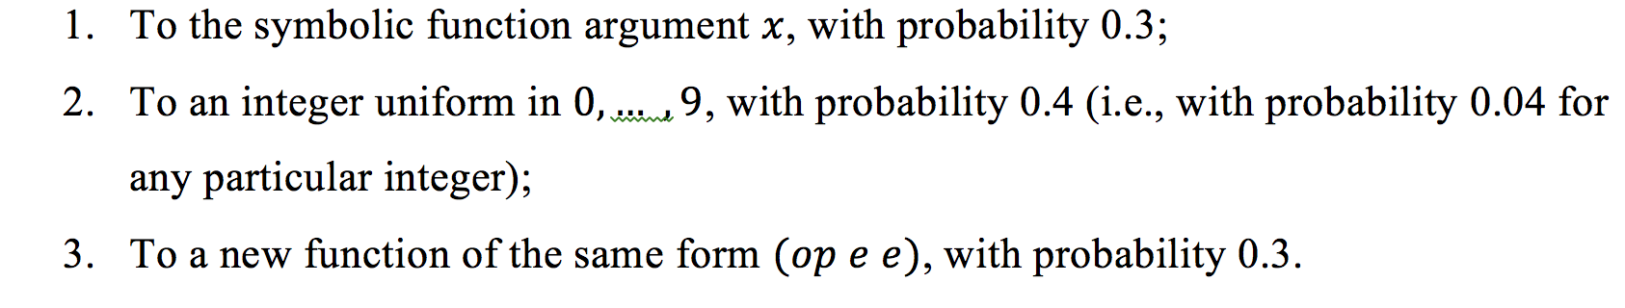
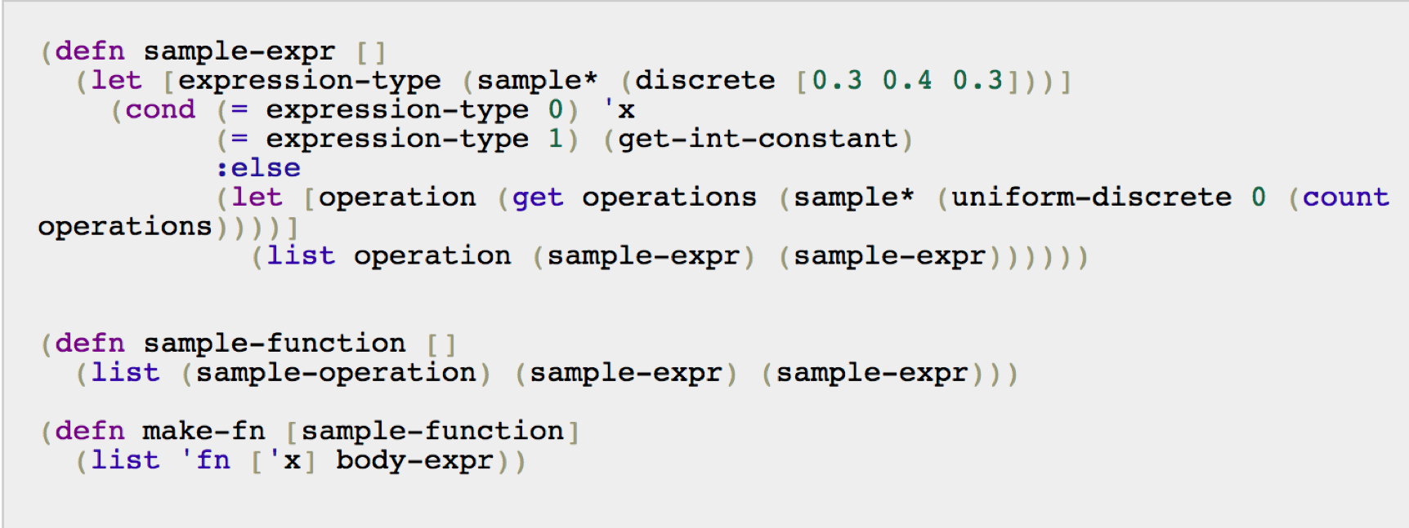
writing sampler
Notes:
We should notice that the program to encode function itself, is a probabilistic program. It has the prior distribution, from which we can sample. This is the Anglican code for sampling expression. …

Slide 23
Notes:
So we can get sample function, which is a list of an operation and two expressions. If we print the sample-function for several times, we get this,

Slide 24
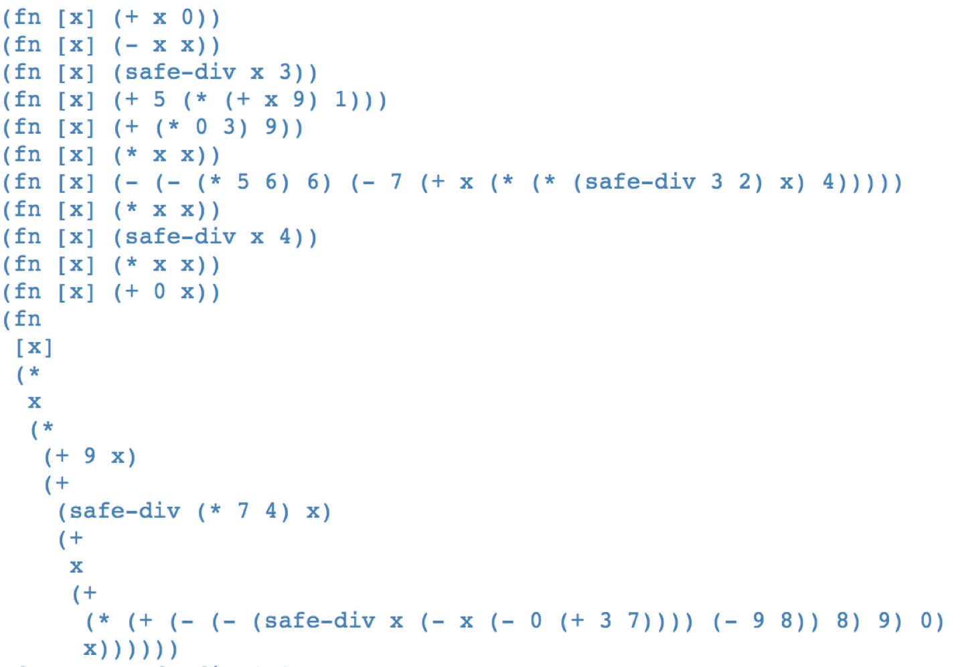

Slide 25
score-function
In addition to writing the mathematical function using Anglican, which draws from the generative model, we also want to write a function which scores functions according to the model. That is, we need to compute ln p(f), where f is a function expression.
Generally, the function which computes the score of an expression is like the function we used to generate the expression, only instead of using `sample` to generate a new random value, we use `log` to evaluate the probability of a fixed value.

Slide 26
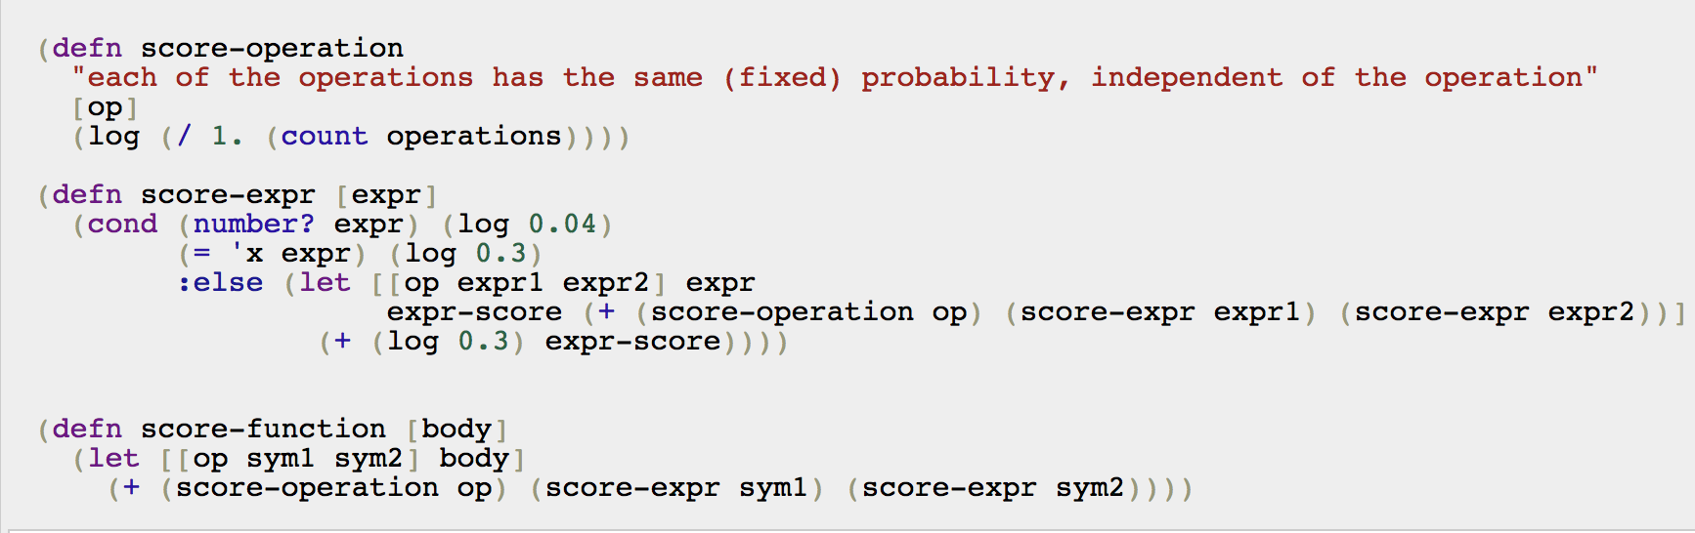
score-function
score-function(fn [x] (- x x)) = ln(0.25*0.3*0.3)=ln(0.0225)=-3.794

Slide 27
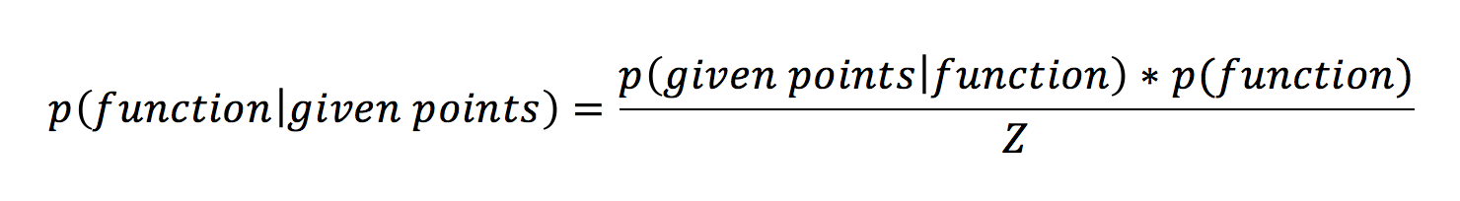
Likelihood
?
Notes:
Let’s recall Bayesian inference, in our example X is function, Y is the input-output examples. And we have already create the prior distribution of X. Now we would ask what is likelihood? Here we also make a likelihood distribution of Y given X, that links the generative model to the data.

Slide 28
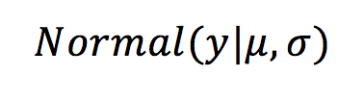
Likelihood
given points: (2,4)
function: f
Notes:
For example, if we have given points(2,4) and the function. we could express "f(2) is approximately 4" by a likelihood term which follows a normal distribution.

Slide 29
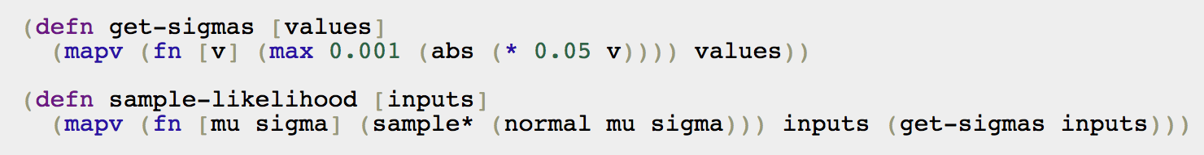
Likelihood
points: (2,4) function: f
Notes:
For given points (2,4) and function f. we let u is f(2), sigma is this. and we will have likelihood p(y=4|f), which is normal distribution. The samples from likelihood distribution is the real output we get. So here input is f(2), the output isy.
We can sample from this generative model, which includes the "noise" in the likelihood.

Slide 30
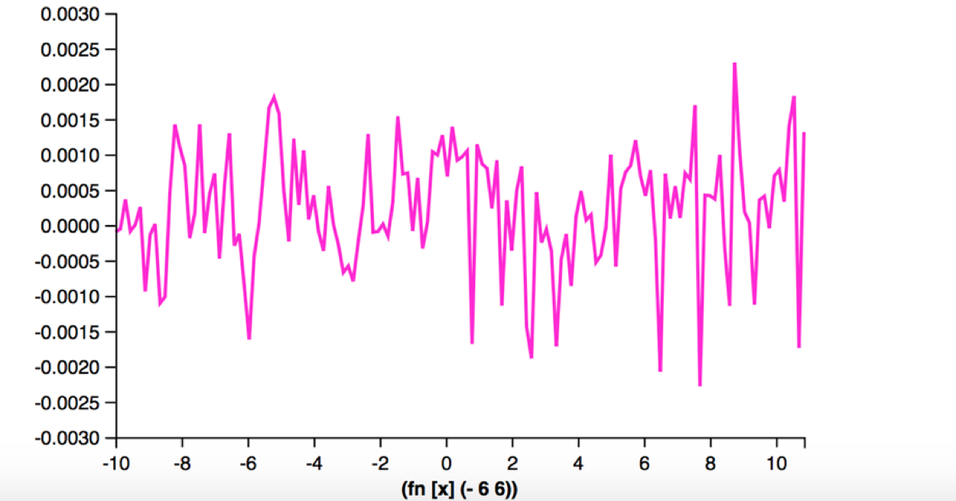
Likelihood
Notes:
If we draw the function, for example, f(x)=0, then what we get is not a line, but like this, 0 with some noise.

Slide 31
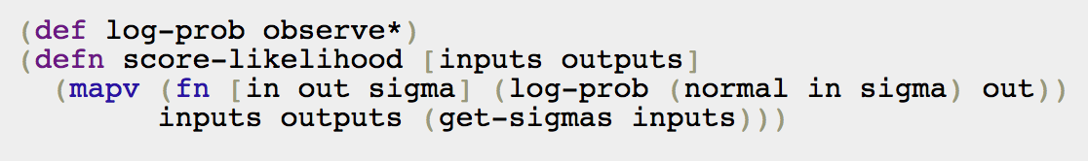


Score-likelihood
Notes:
score-likelihood is log likelihood, it will get a map of score-likelihood of each point

Slide 32
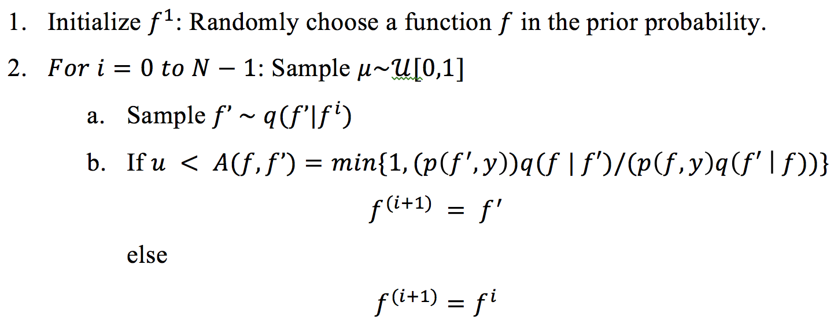
Metropolis Hastings
Notes:
We're going to implement Metropolis-Hastings inference in this model. Metropolis-Hastings requires a proposal distribution for modifying a given expression. This proposal defines a conditional distribution over new function expressions given a current expression. The acceptance probability is .... We need to be able to both sample from proposal distribution q() , as well as compute the probability of the transition for a given pair of expressions.

Slide 33
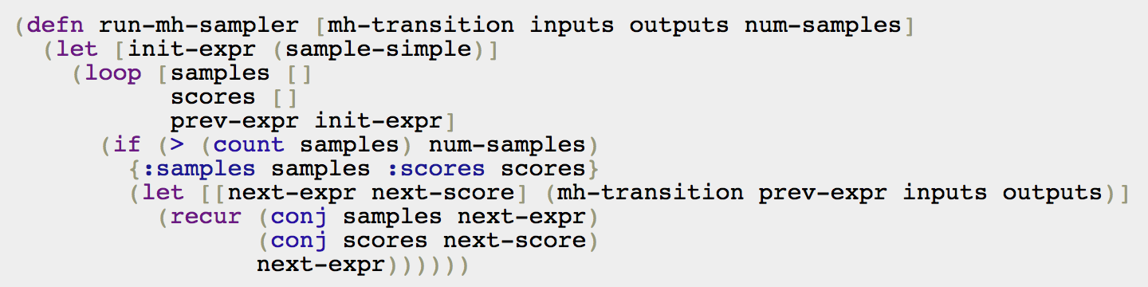
Metropolis Hastings
Notes:
We can use anglican to denote this procedure, that is to run metropolis-hasting altorithm.

Slide 34
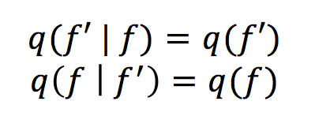
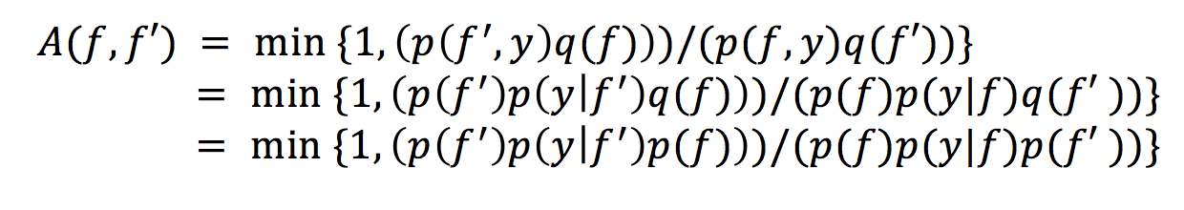
Independent proposal
Notes:
How can we design a Metropolis-Hastings proposal for this model? It is statistically inefficient, but conceptually and programmatically very simple, to define a proposal density which is independent of the input function . Hence the acceptance probability is

Slide 35
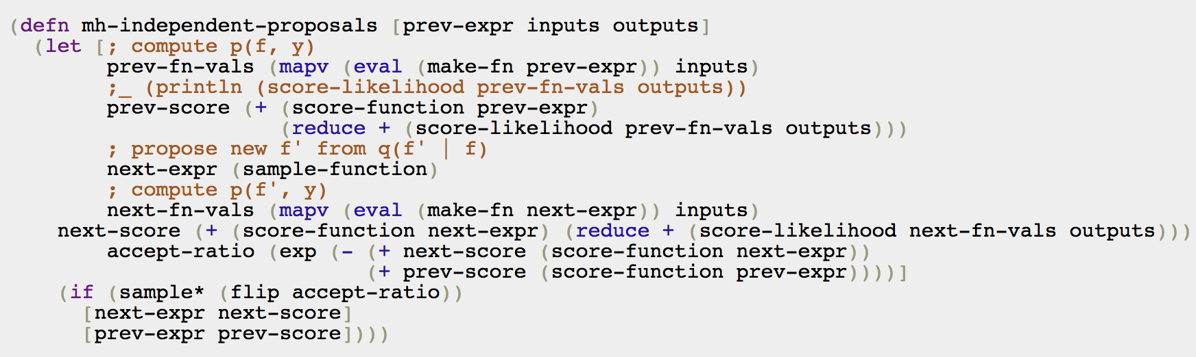
Independent proposal

Slide 36
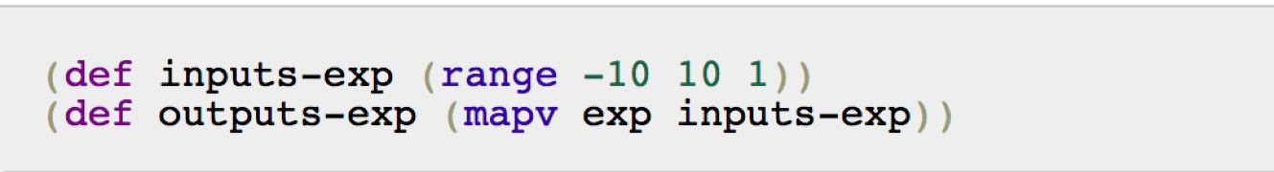
Independent proposal
Notes:
Now given some output data points, after running mh sampling, we can get a sequence of sample programs.

Slide 37
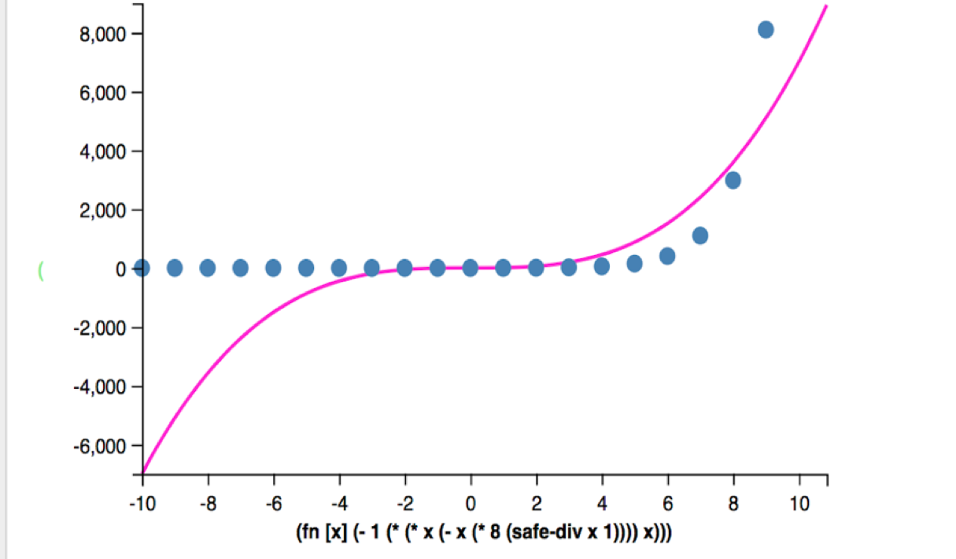
Independent proposal
Notes:
We can draw one of the sample programs.

Slide 38
Dependent proposal
Ideally, instead of proposing independently, we would have a proposal distribution which suggests small perturbations to existing functions. One version of a proposal for this model goes as follows: Suppose is the body of some current sampled function. This function can be represented (visually) as a tree: each of the two sub-expressions is itself either a terminal symbol(i.e. a number or x), or another function.

Slide 39
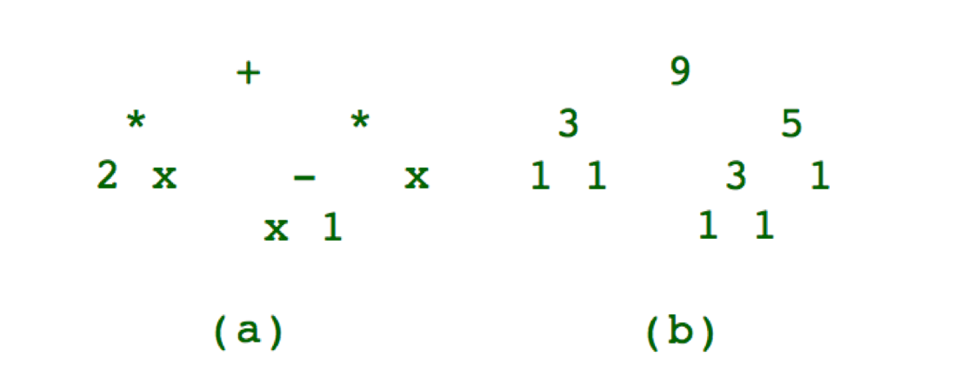
Dependent proposal
For example, the function (fn [x] (+ (* 2 x) (* (- x 1) x))) can be diagrammed as shown in Figure.
Notes:
Figure(b) denote the number of each node, terminal nodes only have one, for operation node, number of it is the sum of left and right and 1.
We can make proposals by picking any one of the nodes in this tree, at random, and then changing its value. The sorts of transitions we can consider are things along the lines of the following choices:

Slide 40
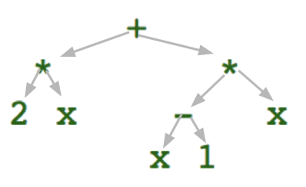
Dependent proposal
Terminal:
0.5: change it to another terminal.
“x”:
q(f’|f)=(1/node_number)*0.5*p(x)
constant: q(f’|f)=(1/node_number)*0.5*p(constant)*0.1
0.5: Replace terminal with a new sub-expression.
q(f’|f)=(1/node_number)*0.5*p(operation)*p(expression_1)*p(expression_2)

Slide 41
Dependent proposal
Operation(sub-expression with no nesting):
0.5: change to another operation
q(f’|f)=(1/node_number)*0.5*p(operation)
0.5: Replace it with terminal(Contract tree)
“x”:
q(f’|f)=(1/node_number)*0.5*p(x)
constant:
q(f’|f)=(1/node_number)*0.5*p(constant)*0.1

Slide 42
Dependent proposal
Operation(sub-expression with nesting):
1.0: change to another operation
q(f’|f)=(1/node_number)*0.5*p(operation)
Notes:
Now we know the proposal distribution, we will use it and run mh sampling as described before and get a sequence of sample functions.

Slide 43
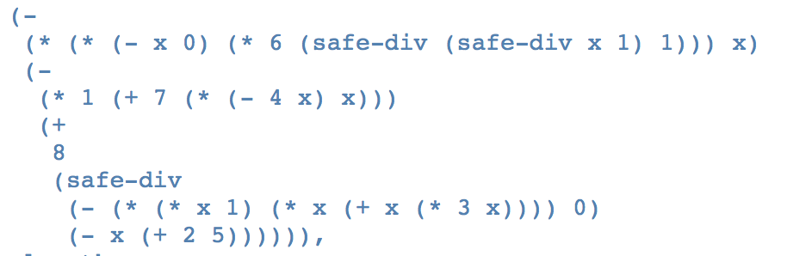
Dependent proposal
Notes:
We can see the some sample function like this, and plot it

Slide 44
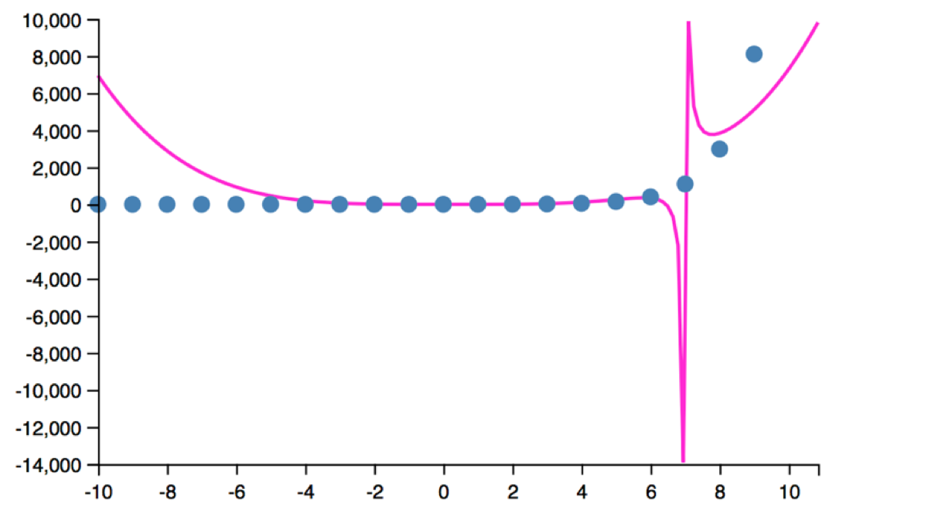
Dependent proposal

Slide 45
Assessment
In order to assess the programs we get, we use the score-likelihood to tell us whether the function is “good” or not. Here “good” means the of function is high. For each model, we will calculate score-likelihood of all samples. The sampling number is 20000 in each model. We run two proposal methods each for 50 times and get the mean score-likelihood of 20000 samples. Since the initial samples are not good samples, we choose to drop the first 1000 samples.
Notes:
The mean score-likelihood is shown in Figure 5.17. The blue one is independent proposal, the red one is dependent proposal.

Slide 46
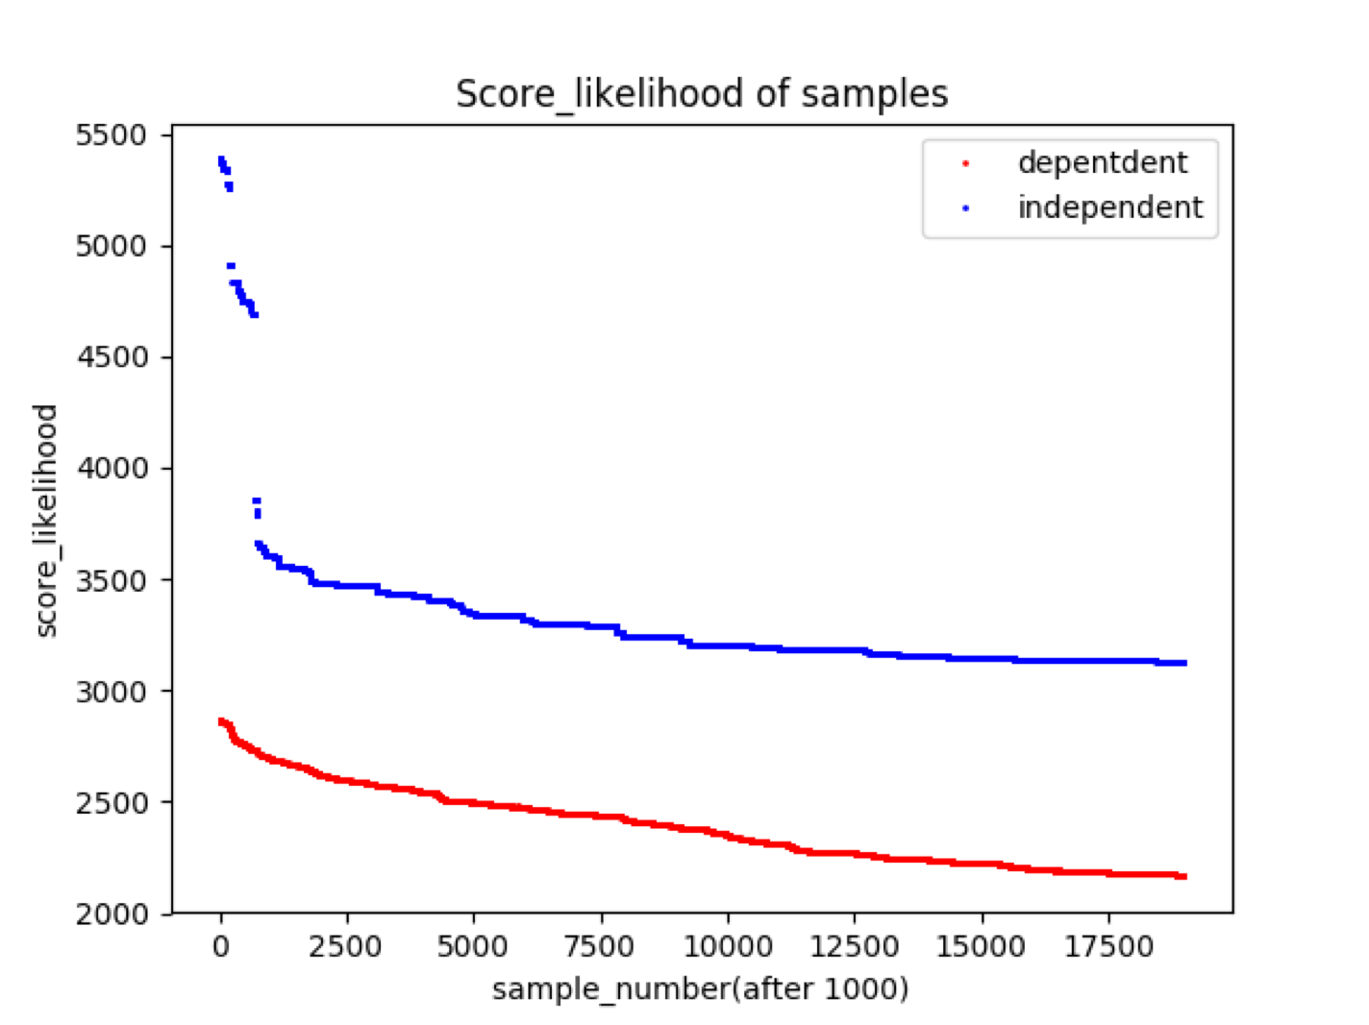
Assessment
converges?
Notes:
One thing we care about is whether Markov chain reaches convergence. In Figure 5.17 independent method, mean score-likelihood varies smoothly after about 2000, however, the score-likelihood still continues to become smaller with sample number increasing. That makes it difficult to tell whether the chain converges or not. And obviously, in this example, convergence can’t be got in independent method since in dependent method, score-likelihood can get much smaller than that in independent one even at 20000th sample.

Slide 47
Assessment
which is better?
Notes:
However, though we cannot tell convergence of Markov chain, we can compare two proposal methods of MH. We can find that score-likelihood of dependent proposal is always smaller than that of independent one given same sampling number, which means, programs that sample with dependent proposal method are better than that in independent one.Moreover, we can tell that after about 2000 sampling, score-likelihood of both methods vary smoothly, the number of sampling will but not obviously influence score-likelihood. In this case, even after sampling for 20000 times in independent method, mean score-likelihood is slightly bigger than samples at 1000 time in dependent method. Therefore, we can conclude that dependent proposal method performs better than independent one.
So we can see that create a proper proposal distribution is quite important for convergence.

Slide 48
Metropolis-Hastings
The success or failure of the algorithm often hinges on the choice of proposal distribution. If the proposal is too narrow, it runs the risk of getting stuck in local maxima: areas where the likelihood is higher for a certain value than for its close neighbors, but lower than for neighbors that are further away.
On the other hand, if it is too wide(independent proposal), then many of the proposals would be outside the target distribution, the rejection rate can be very high.
Notes:
This is because of the property of MH

Slide 49
Conclusion
Through this project, I have a understanding of what probabilistic program is and how to perform MH inference using Anglican. It is really a good experience for me.

Slide 50
Thank you!

